Slide 1

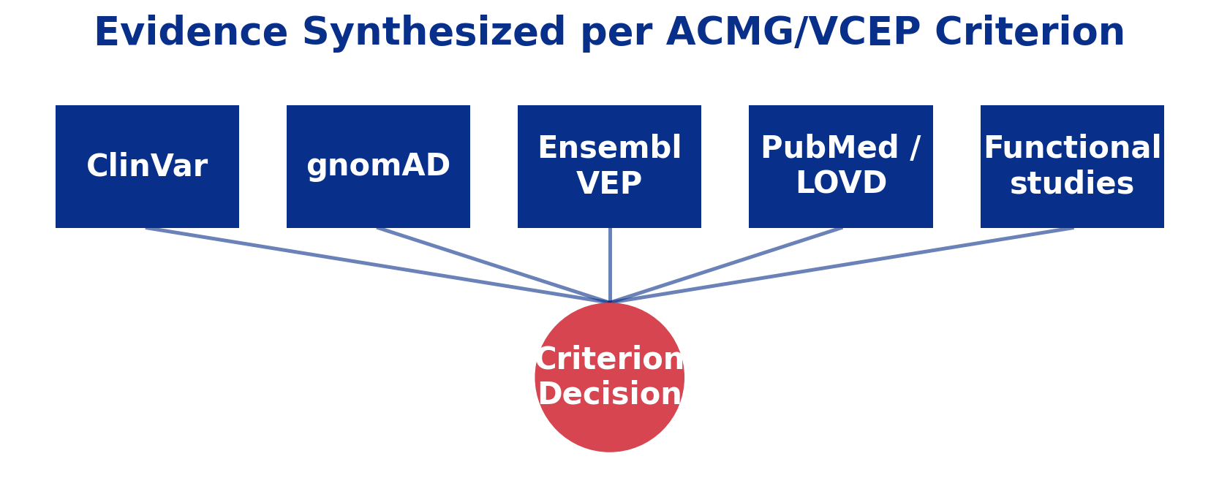
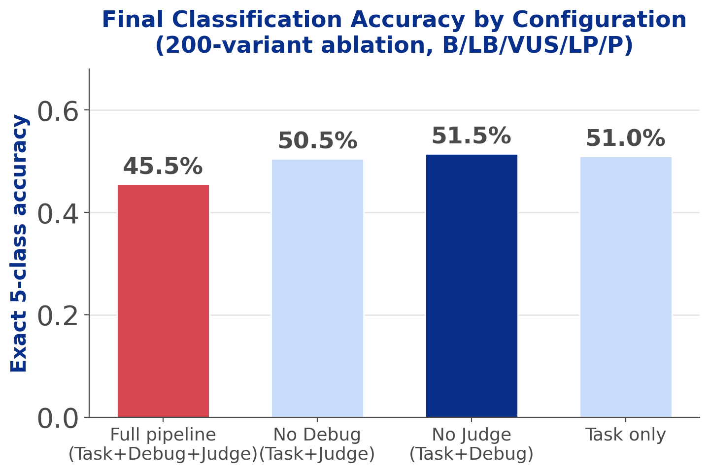
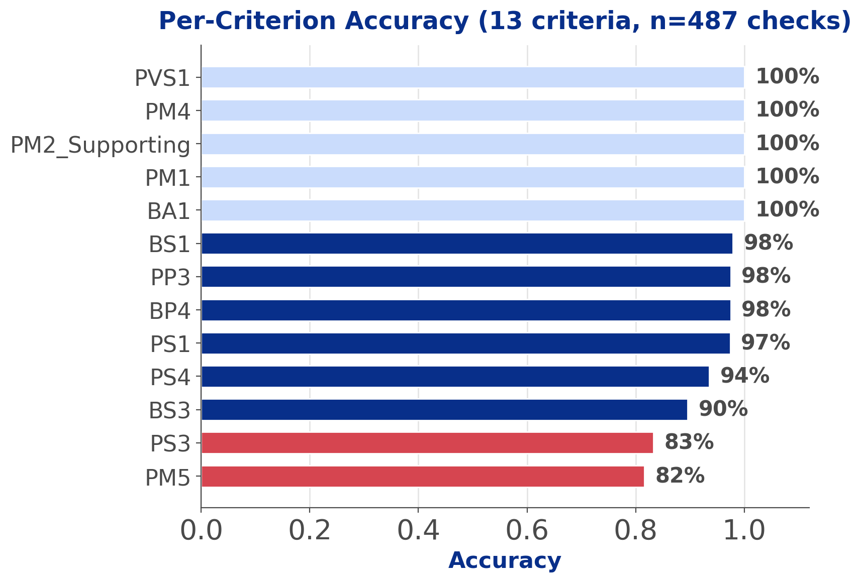
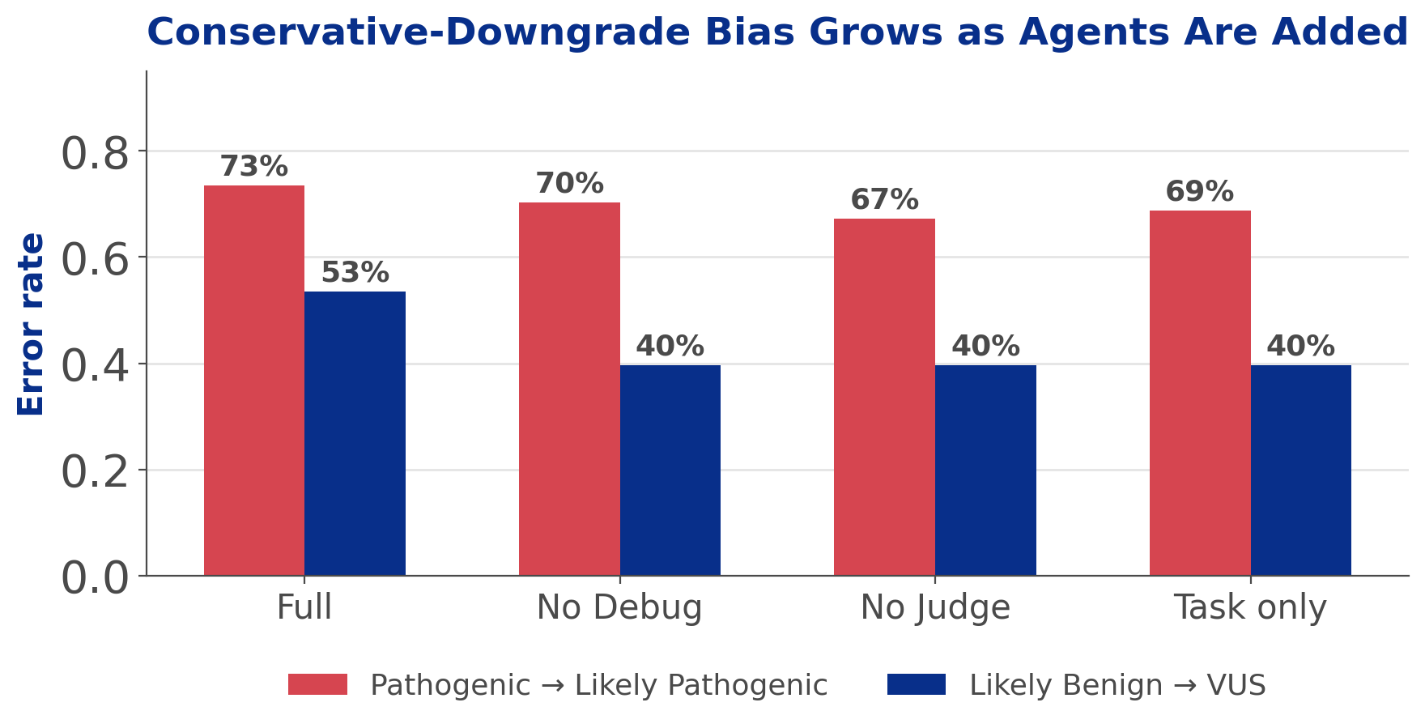
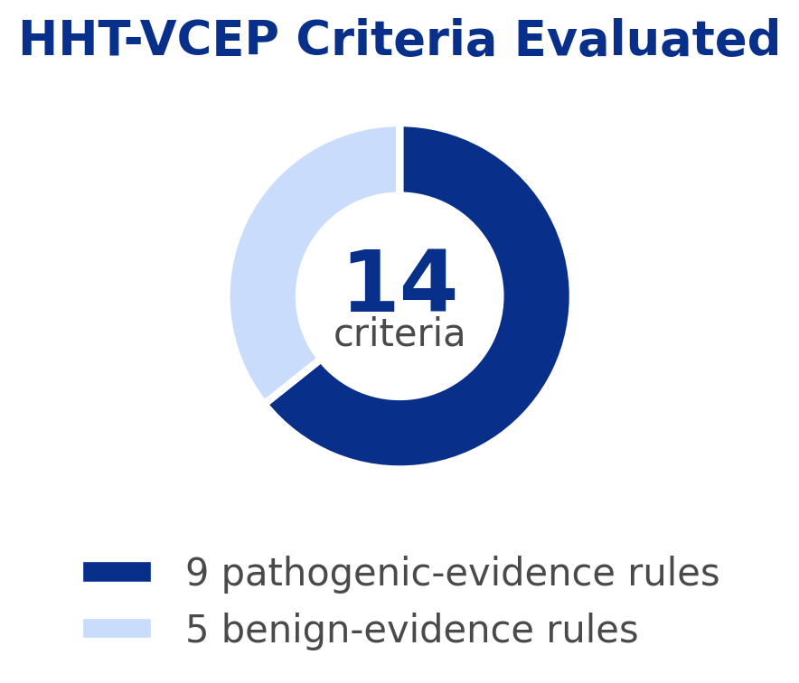
AI Agents for Scientific Discovery
Ashkan Khilwatgar ‘28, Suning Hong ‘27, Simon Li ‘29, Wenbo Wang
Computer Science Department
Motivation
Methodology
Background: Classifying genetic variants under ACMG/AMP and VCEP guidelines requires synthesizing evidence from ClinVar, gnomAD, Ensembl VEP, PubMed, and LOVD — a slow, reasoning-heavy task normally done by expert human curators.
Research question: Are AI agents advanced enough to perform complex, reasoning-heavy clinical tasks?
Case study: we test this on ACVRL1/ENG variants in Hereditary Hemorrhagic Telangiectasia (HHT), scoring pipeline output against VCEP expert-panel gold-standard classifications.
Annotate (VEP)
Plan
Gather Evidence
Judge
Score
A LangGraph multi-agent pipeline applies ACMG/AMP and HHT-VCEP criteria to each variant:
1. Ensembl VEP annotates variant consequence and gene.
2. A deterministic Plan agent builds a phased task list from a curated PlanRAG knowledge base.
3. Criteria run in parallel per phase, with dependencies enforced (e.g. PM5 requires PM1).
4. Per criterion: Task agent gathers evidence (ClinVar, gnomAD, PubMed, LOVD, functional studies) → Debug agent catches tool errors → Judge agent decides applicability → Check agent validates formatting.
5. A Scoring step combines all applied criteria into a final call (Pathogenic → Benign).
All reasoning agents run on Gemini via Vertex AI, rate-limited across concurrent branches.
Results
Conclusion
45.5%
Final classification accuracy, full pipeline (n=200 variants)
94.4%
Per-criterion accuracy (n=487 checks)
51.5%
Best config: Task+Debug, no Judge (n=200)
AI agents reason well per-criterion (94.4%) but combining evidence into one final call is the bottleneck (45.5% exact-match, n=200).
Reliability gaps that remain:
Debug/Judge amplify a conservative-downgrade bias instead of correcting it — full pipeline is 6 points worse than Task-only.
Judge-agent checks are stochastic — identical code/prompts re-run on the same variants produce different accuracy.
PM5 and PS3 are the weakest criteria; PS3 traces to an LLM step over-filtering functional-evidence abstracts.
Next steps:
Recalibrate Debug/Judge's evidence bar, not just retry/oscillation handling.
Fix the LLM filtering step under-retrieving PS3/BS3 evidence.
Run multiple ablation replicates before extending evaluation beyond HHT.
On the full 200-variant HHT set, exact-match accuracy is 45.5% — but per-criterion reasoning is far stronger (94.4%, 487 checks), so most of the gap is in combining criteria, not evaluating them.
Dominant error: a "one notch less confident" bias — 47/64 Pathogenic variants called Likely Pathogenic; 31/58 Likely Benign called VUS.
Removing Debug/Judge improves accuracy (51.5% vs. 45.5%) — they nudge borderline calls more conservative rather than correcting them.
Weakest criteria: PM5 (82%) and PS3 (83%) — PS3's LLM filtering step over-rejects relevant functional-evidence papers.

